Slide 1
Data Analysis on Stock Prices
Alvin Lim

Slide 2
Background
With the vast amount of information available about the stock market, many still struggle to determine the best time to invest or what to invest in.
My friend, Johnathan is eager to start investing but is hesitant due to the common fear that people have lost their entire life savings in the stock market.
Today, my presentation will serve as a practical guide to help him navigate his investing journey, using data-driven insights and machine learning to make informed decisions.

Slide 3
Dataset
Dataset name | Total number of rows | Total number of columns | URL
VIX | 8836 | 5 | Yahoo Finance (Python Package yfinance pull)
S&P 500 | 8836 | 5 | Yahoo Finance (Python Package yfinance pull)
S&P 500 biggest index (stocks) | 193212 | 30 | Yahoo Finance (Python Package yfinance pull)
S&P 500 companies | 502 | 15 | https://www.kaggle.com/datasets/andrewmvd/sp-500-stocks
Import the dataset
Merge/filter dataset
Upload to MongoDB
Analysis
Check for missing values

Slide 4
 | Dataset 1 | Dataset 2 | Dataset 3 | Dataset 4
Data Information | VIX measures volatility in the S&P 500 | S&P 500 stock price | Stock prices of Meta, Apple, Amazon, Netflix, Google (S&P 500 biggest index stock), and Microsoft. | Companies found in S&P 500
Market open and market close (price/index) | ✔ | ✔ | ✔ | X
Stock price | X | ✔ | ✔ | ✔
Date Range | Jan 1 1990 to Jan 30 2025 | Jan 1 1990 to Jan 30 2025 | Since inception to Jan 30 2025 | X
Trading Volume | X | ✔ | ✔ | X
Other distinct features of dataset | Intraday highest index, intraday lowest index | Intraday highest trading price, intraday lowest trading price | Intraday highest trading price, intraday lowest trading price | Sector information, Market cap, industry information, individual percentages for each company

Slide 5
Aims of the presentation
Educate Johnathan about S&P 500
Overall growth trend for S&P 500
What sectors are involved
What individual stocks he can invest in?
Predict stock price using machine learning

Slide 6
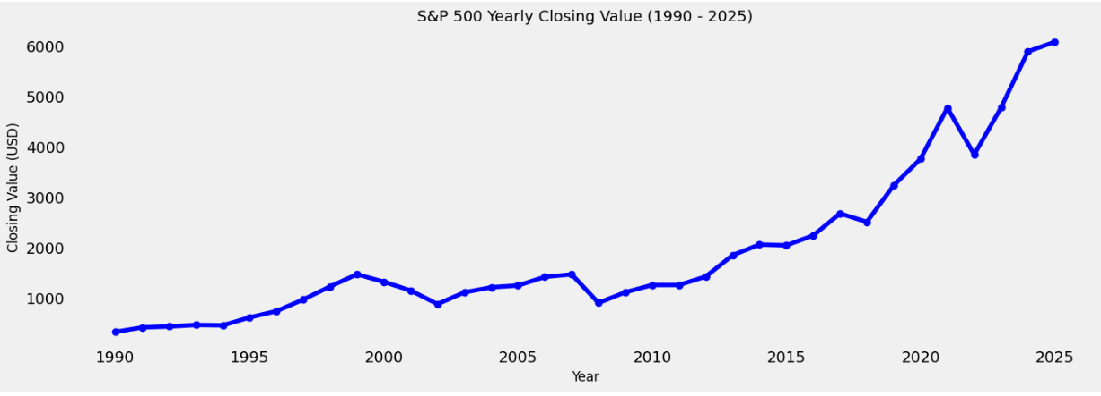
S&P 500 yearly growth (Dataset 2)

Slide 7
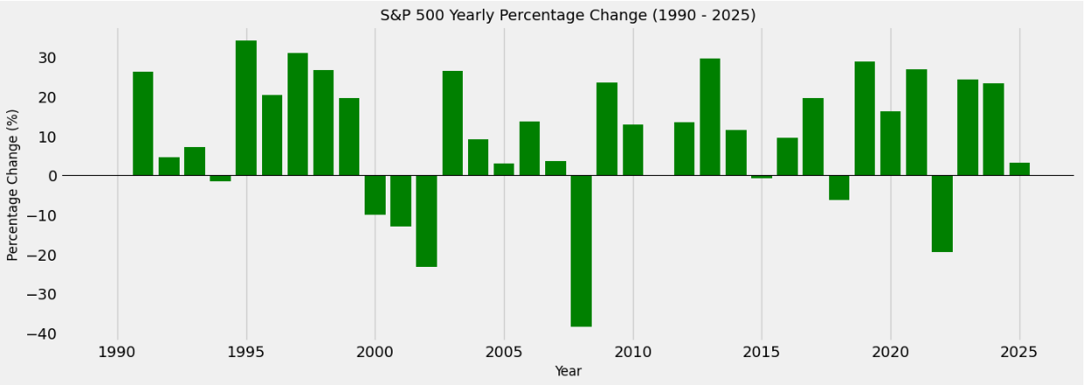
S&P 500 percentage change (Dataset 2)

Slide 8
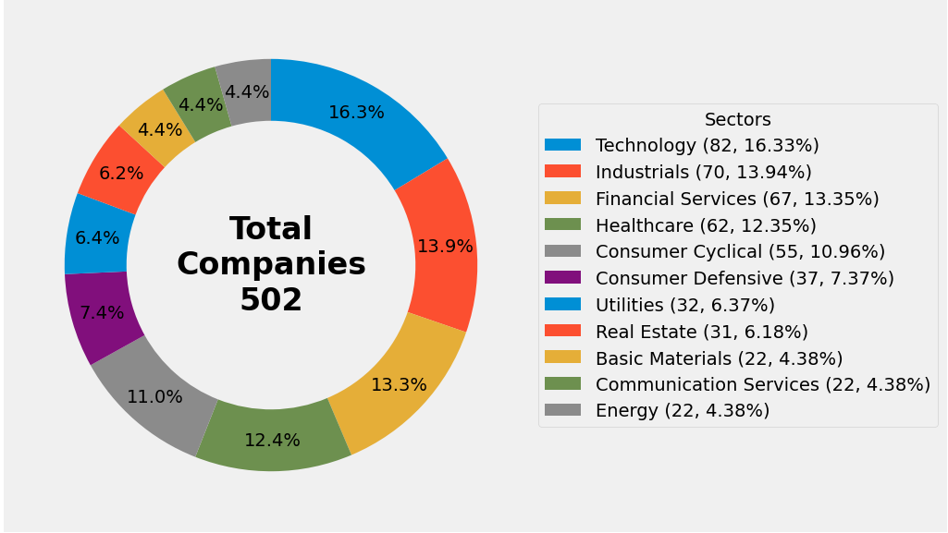
S&P 500 sectors(Dataset 3)

Slide 9
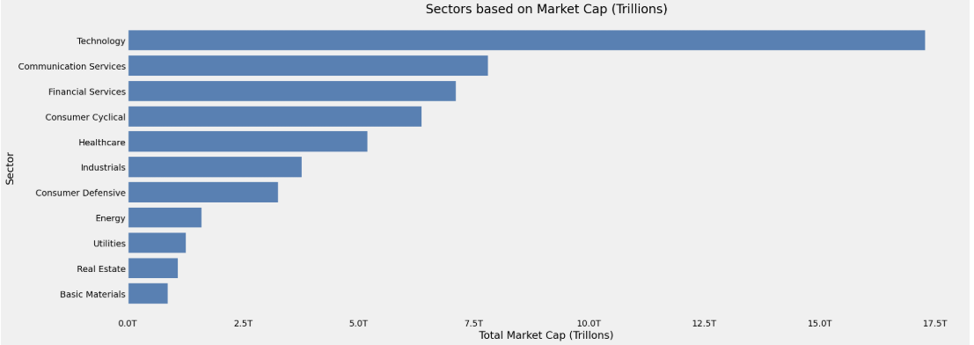
S&P 500 market cap(Dataset 3)

Slide 10
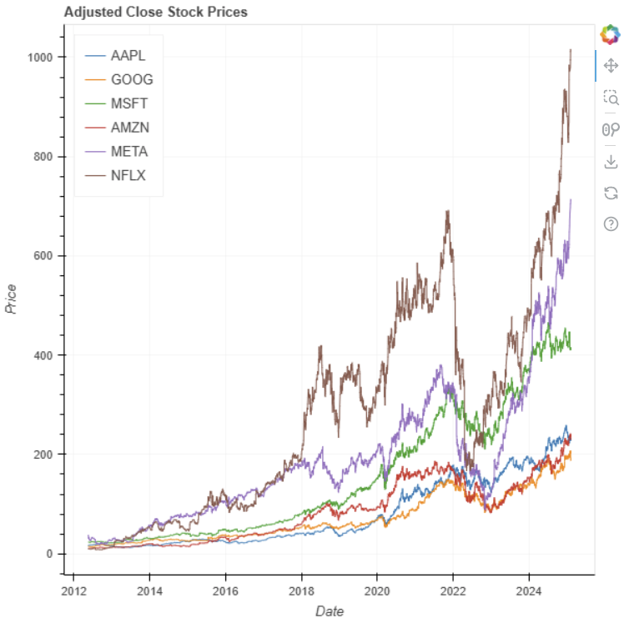
S&P 500 biggest index

Slide 11
Dataset 1 & 2 – Machine learning and time series analysis
Dependent variable | Data type | Data Dictionary
Lag Features | Previous day closing price, closing price from 5 days ago, previous day VIX index, VIX index from 5 days | Close_Lag1, Close_Lag5, Vix_Lag1, Vix_Lag5
Time based features | Day of the week, Quarter, Month, Year, which day of the year, which day of the month, which week in the particular year | Dayofweek, quarter, month, year, dayofyear, dayofmonth, weekofyear
Moving averages | 7-day moving average , 20-day moving average , 50-day moving average, 100-day moving average, 200-day moving average | Close_MA7, Close_MA20, Close_MA50, Close_MA100, Close_MA200
Volatility | 20-day standard deviation of trading volume, 30-day standard deviation of the closing price, 30-day standard deviation of the VIX | Volume_Volatility20, Close_Volatility30, Vix_Volatility30
Trading volume | 20-day average trading volume, Percentage change in volume from the previous day, | Volume_MA20, Volume_Change,
Outcome variable
Closing price | Closing price of each day from Jan 1 1990 to Jan 30 2025. | Close
Dataset merged - VIX closing index (Dataset 1) and S&P 500 (Dataset 2) intraday closing price and trading volume.
Machine learning model used - XGBoost

Slide 12
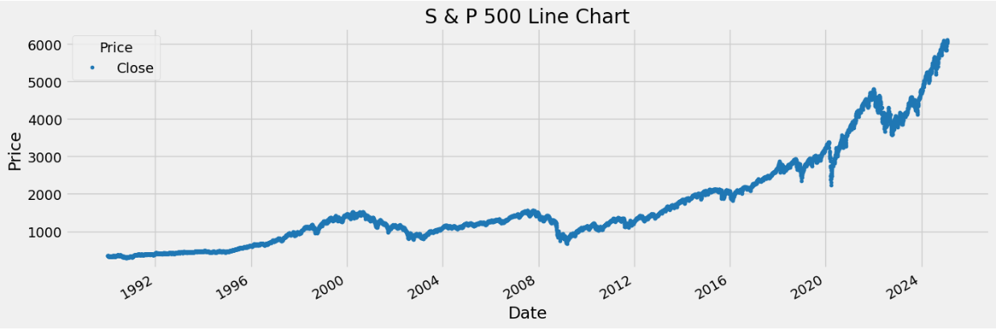
S&P 500 from Jan 1st 1990 to Jan 31st 2025

Slide 13
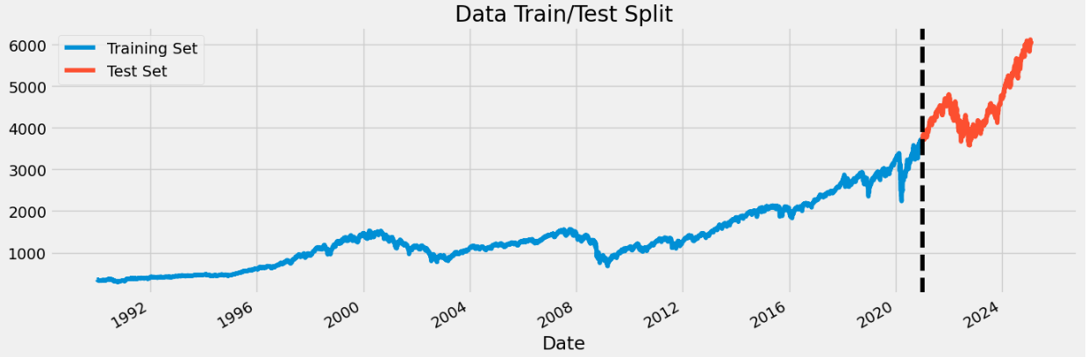
Split training and test data (date cutoff point – Jan 1st 2021)

Slide 14
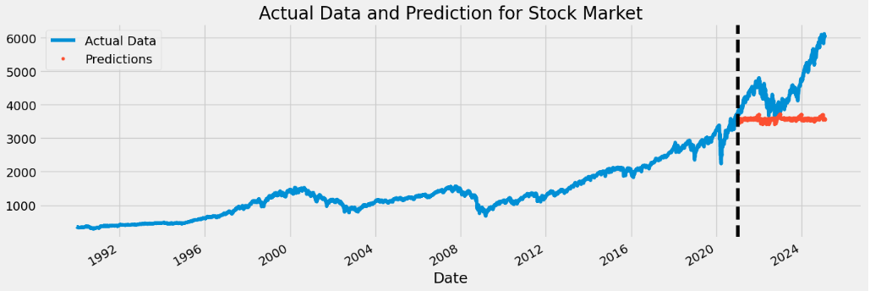
Actual stock price vs. XGBoost prediction
Notes:
your predictions remain relatively flat.
The stock market is highly dynamic and influenced by multiple factors, such as macroeconomic events, interest rates, geopolitical tensions, and company earnings reports.

Slide 15
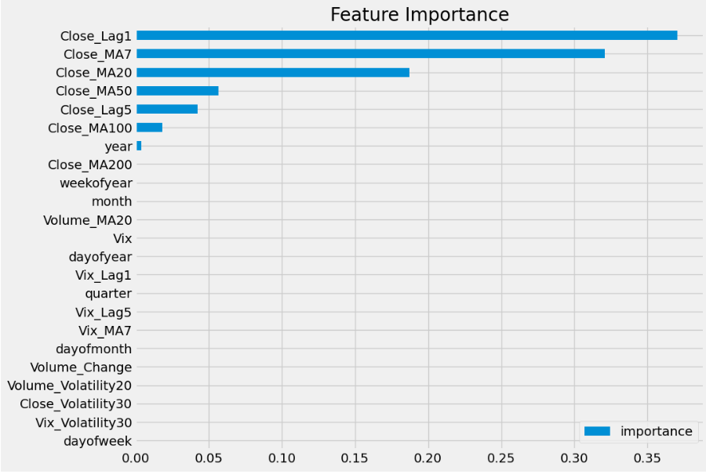
Feature importance ranking

Slide 16
Conclusion
Training Root Mean Squared Error (RMSE) (7.25) is much lower than Test RMSE (1156.49).
This is a sign of overfitting → The model memorized training data but does not generalize well.
Model was trained only on historical stock prices
This model lack crucial economic indicators
Inflation rates
Interest rates (e.g., Fed rate hikes)
Global economic indicators (e.g., GDP growth, unemployment rates)
Market sentiment (e.g., news sentiment, earnings reports)
Can consider time-series cross-validation

Slide 17
Questions?

